Slide 1
MAT in Primary Care – Leadership Roadmap
Design
Build
Enable
Connect
Pilot
Scale
Leadership
Scope+Champion
Approve Protocols
Staffing Model
Validate Network
Oversee Pilot
Expand Program
Clinical
Escalation Pathways
Build Protocols
Validate Flows
Align Counseling
Manage Cohort
Increase MDs
Operations
Workflow Impact
Scheduling Model
Train Staff
Referral Workflows
Monitor Flow
Expand Capacity
Behavioral
Integration Model
Referral Partners
Warm Handoffs
Community Network
Track Engagement
Scale Network
IT
Compliance Setup
Doc Requirements
Build Tools
Referral Tracking
Dashboards
Maintain Reporting
Above is an overview of a comprehensive approach to preparing for an implementing MAT in a standard primary care clinic where this has previously not existed.

Slide 2
Overview of Roadmap Phases
PHASE 1: DESIGN & ALIGN
Leadership: Define scope, champion, approve policies
Clinical: Define escalation pathways
Ops: Assess workflow impact
Behavioral Health: Define integration
IT/EHR: Assess compliance needs
PHASE 2: BUILD MODEL
Leadership: Approve protocols
Clinical: Develop diagnosis, induction, response protocols
Ops: Design scheduling, no-show workflows
Behavioral Health: Identify referral pathways
IT/EHR: Define documentation requirements
PHASE 3: ENABLE TEAM & TECH
Leadership: Confirm staffing
Clinical: Validate workflows
Ops: Train staff (UDS, PDMP)
Behavioral Health: Train on integration
IT/EHR: Build templates, tracking
PHASE 4: CONNECT ECOSYSTEM
Leadership: Validate network
Clinical: Align counseling expectations
Ops: Implement referral workflows
Behavioral Health: Establish community resources
IT/EHR: Enable referral tracking
PHASE 5: PILOT & MONITOR
Leadership: Oversee pilot
Clinical: Manage cohort
Ops: Monitor visit flow
Behavioral Health: Track engagement
IT/EHR: Reporting dashboards
PHASE 6: SCALE
Leadership: Expand program
Clinical: Increase prescribers
Ops: Expand scheduling
Behavioral Health: Scale network
IT/EHR: Maintain reporting

Slide 3
MAT Clinic Initiation
Each phase which follows lists the items that are needed for the buildout of an MAT clinic in the primary care setting.
This is to provide clarity and actionable items surrounding the logistics for the initial set up.
Each phase has a possible amount of time they may take.
Leadership buy in and engagement is needed at all phases.

Slide 4
Phase 1 – Strategic Alignment & Program Design (Weeks 0–4)
Goal: Define scope, leadership, and compliance foundation before any clinical activity
Key Focus Areas
Program Leadership & Scope
Identify MAT clinical lead/champion
Define service scope:
  Induction vs. maintenance
  Office vs. home induction
Establish escalation pathways (psychiatry, IOP, OTP)
Regulatory & Policy Framework
Review Tennessee/state requirements and payer expectations
Develop:
  MAT policies & procedures
  Informed consent
  SUD treatment agreement
Ensure HIPAA + 42 CFR Part 2 compliance
Governance Decisions
Confirm prescriber readiness (DEA/buprenorphine prescribing authority
Define non-punitive discharge/transfer policies
Deliverables
Approved MAT program charter
Signed policies/protocol drafts
Leadership “go/no-go” for build

Slide 5
Phase 2 – Clinical & Operational Infrastructure Build (Weeks 4–8)
Goal: Build the standardized clinical and operational backbone
Key Focus Areas
Clinical Protocol Development
OUD diagnosis & assessment workflow
Buprenorphine induction & stabilization protocols
Standard responses for:
  Missed visits
  Relapse/UDS findings
  Diversion concerns
Monitoring & Safety Systems
UDS protocols + standardized panels
PDMP workflow and documentation
Naloxone prescribing and education workflow
Pill/film count processes
Clinic Workflow Design
MAT visit types + longer induction slots
No-show + urgent access protocols
Pharmacy alignment
Deliverables
Finalized clinical protocols
Standard workflows mapped (front desk → provider → follow-up)
Draft scheduling template

Slide 6
Phase 3 – EHR Build, Staffing, & Training (Weeks 6–10, overlaps Phase 2)
Goal: Operationalize workflows through people + technology
Key Focus Areas
EHR Configuration
MAT intake and follow-up templates
Smart phrases (PDMP, UDS, counseling)
Tracking tools:
  Missed visits
  UDS results
  Agreement compliance [
Team Roles & Staffing
Define:
  Prescriber
  Nursing/MA workflows
  Behavioral health integration
  Care coordination
Staff Training
Stigma-informed + trauma-informed care
Motivational interviewing
De-escalation skills
Deliverables
Fully built EHR toolkit
Staff competency validation complete (fits your training model)
Clear role-based workflows

Slide 7
Phase 4 – Community Integration & Care Model Activation (Weeks 8–12)
Goal: Ensure patients can access the full continuum of care
Key Focus Areas
Behavioral Health & Referral Network
Counseling and therapy referral list
Psychiatry access
Community recovery resources (NA, SMART, virtual options)
Care Coordination Model
Warm handoff workflows
Expectations for counseling engagement (supportive, not punitive)
Patient Education
MAT handbook + induction instructions
Safe storage + overdose prevention education
Clear communication pathways for urgent needs
Deliverables
Active referral network
Patient-facing materials ready (ideal for your quick guides)
Care coordination workflows live

Slide 8
Phase 5 – Pilot Launch & Quality Monitoring (Weeks 12+)
Goal: Start small, monitor closely, and refine
Key Focus Areas
Pilot Implementation
Limited patient cohort
Selected prescribers only
Increased visit cadence early
Quality & Safety Monitoring
Metrics:
  Retention rates
  UDS adherence
  Overdose prevention measures
Adverse event reporting
Chart review + QI cycles
Continuous Improvement
Weekly/biweekly case reviews
Workflow adjustments based on frontline feedback
Deliverables
Pilot performance dashboard
QI action plan
Decision to scale

Slide 9
Phase 6 – Full Program Scale & Optimization
Goal: Expand access and standardize across clinics (aligned with your system-level work)
Key Focus Areas
Expand prescriber pool
Increase MAT appointment capacity
Standardize across sites (if CMG-wide)
Ongoing staff training + refreshers
Integration into routine primary care workflows

Slide 10
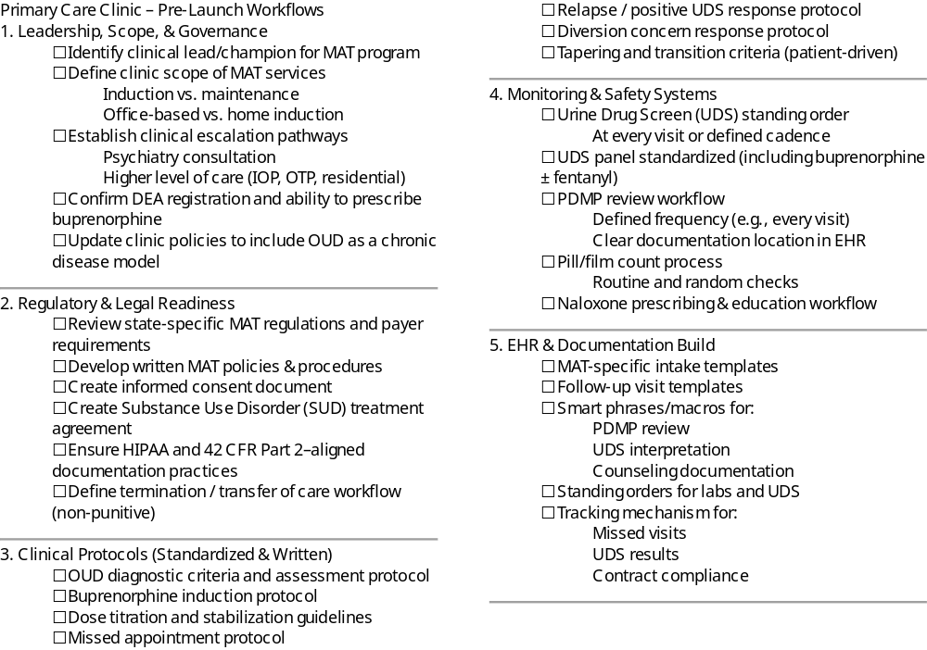
MAT in Primary Care Readiness Checklist

Slide 11
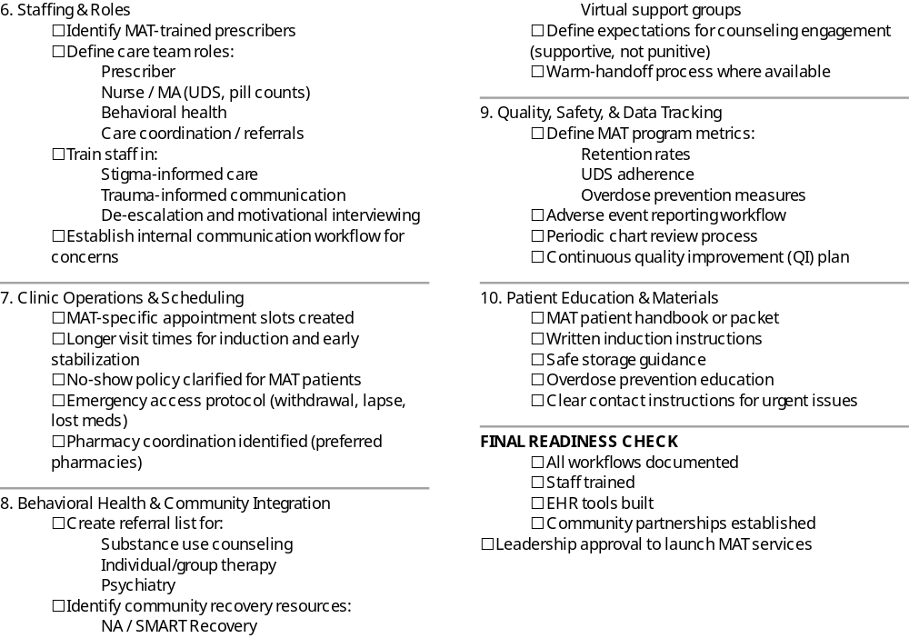
MAT in Primary Care Readiness Checklist

